Slide 1
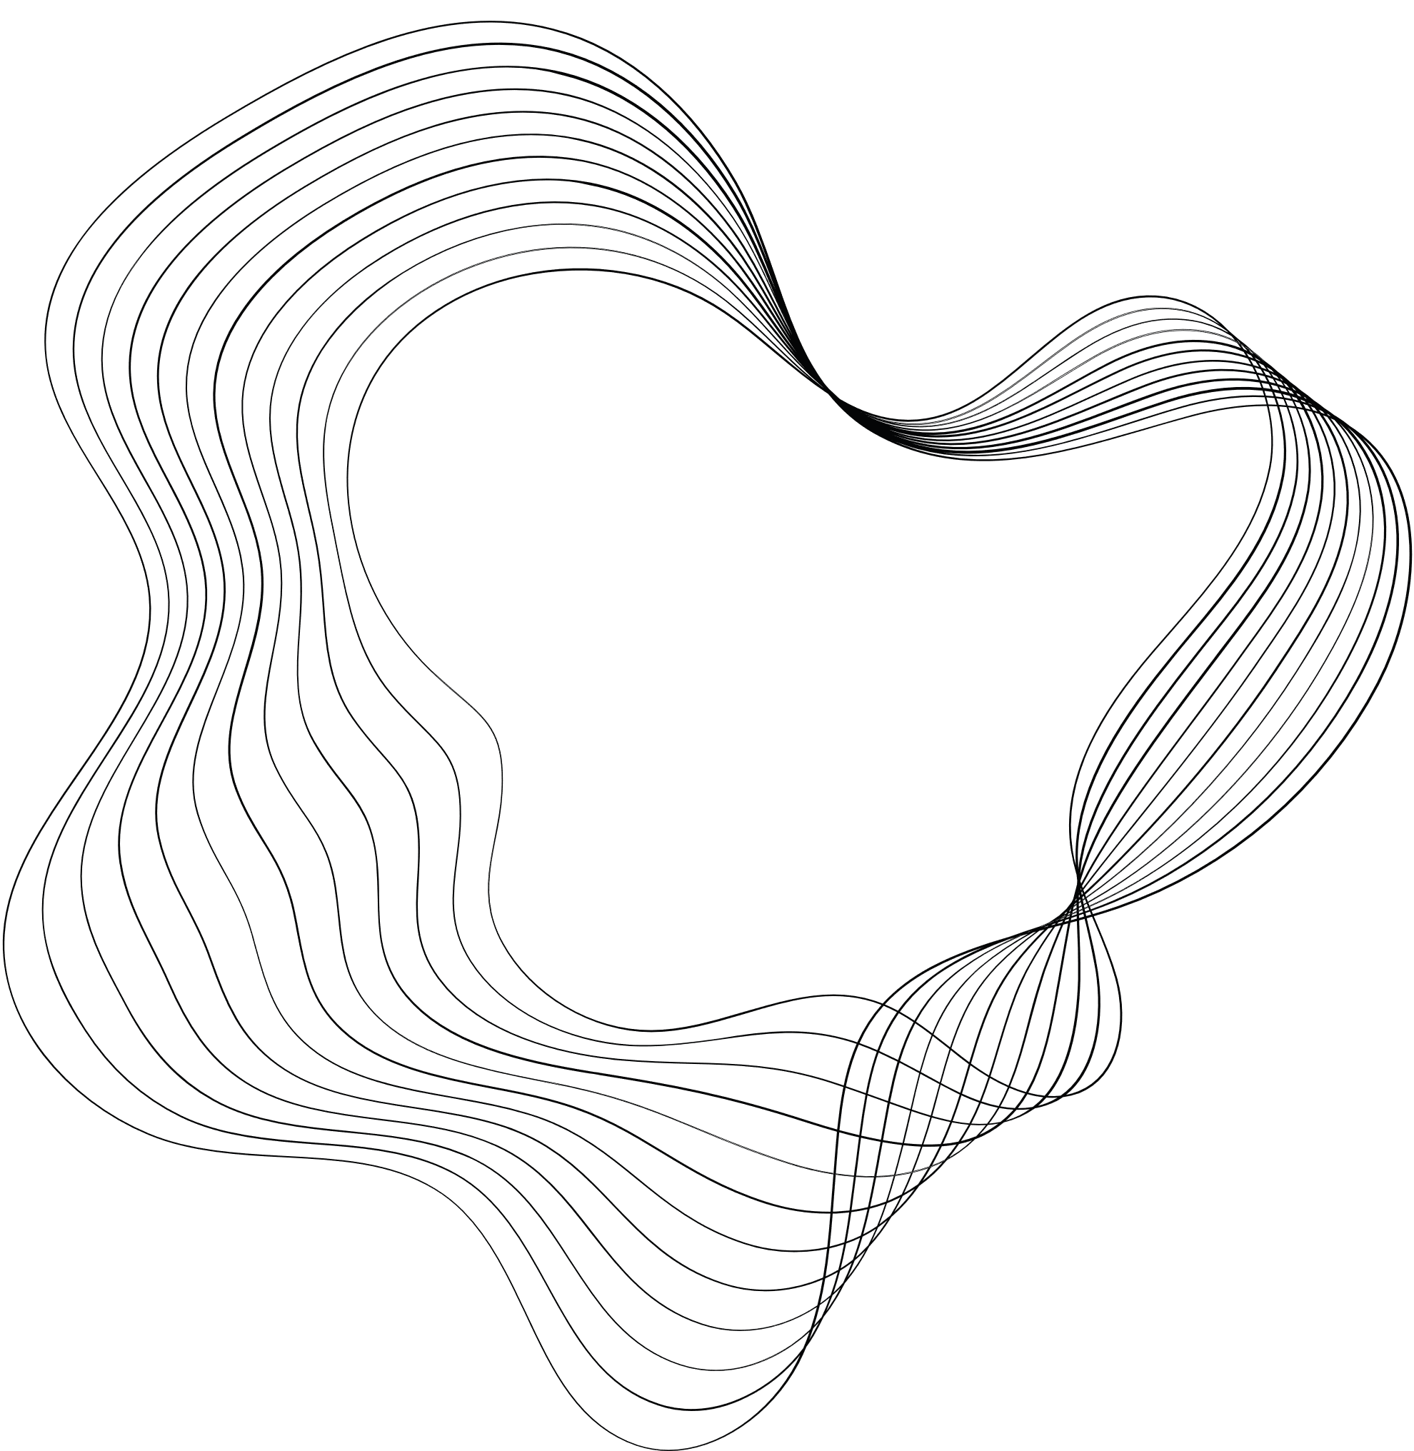


ALL OPTIMISATION FRAMEWORK FOR MERGING MULTIPLE RESULT LISTS

Slide 2
TEAM MEMBERS:
1.SASIDHARAN GS
2. SIVABALAMURUGAN
3. ABHIRUP PAUL
4. DEVAGANGA VV
5. ANJALI GANESHAN

Slide 3

ABSTRACT
1. Effective fusion of multiple ranked document lists is essential for various applications like federated web search.
2. A neural network-based approach called LambdaMerge is studied and extended for merging ranked lists from one or more verticals.
3. The model considers document quality, ranked list quality, and vertical impact in an optimization framework.
4. Deep structures are explored to improve evidence combinations.
5. Experimental results show that the proposed approach outperforms standard baselines and state-of-the-art methods in both collection and data fusion.

Slide 4
INTRODUCTION
1. Effective fusion of ranked document lists is crucial for applications like web-scale federated search, which involves blending results from various sources.
2. Fusion techniques are broadly categorized into data fusion and collection fusion, with collection fusion focusing on merging results from multiple collections, also known as federated search, for efficiency reasons.
3. Data fusion, on the other hand, merges results from a single document collection to improve precision and recall.
4. Recent developments in data fusion algorithms use training queries and relevance signals to optimize retrieval performance metrics.
5. LambdaMerge is a data fusion technique that directly optimizes retrieval metrics by combining features related to document relevance and query quality.

Slide 5
INTRODUCTION
6. While LambdaMerge has shown strong performance in data fusion, its adaptation to collection fusion remains unclear.
7. In this paper, the authors extend LambdaMerge to consider the impact of results drawn from different verticals, introducing a scoring function that optimizes overall retrieval effectiveness.
8. Inspired by the success of deep structures, the model incorporates a deep neural network (DNN) for learning the scoring function.
9. Extensive experiments demonstrate that integrating vertical signals significantly improves retrieval effectiveness in collection fusion, and deep structure models consistently outperform other approaches in both fusion scenarios.
10. The paper also introduces new features that characterize the quality of ranked lists, which are more semantically informative compared to previous approaches.

Slide 6
MERGING MULTIPLE RESULTS LIST
Preliminaries of λ-Merge
1. Effective document list fusion is critical for many applications, and learning-based approaches often outperform traditional unsupervised methods due to their ability to incorporate additional features and customized objectives.
2. One notable learning-based approach is λ-Merge, which directly optimizes retrieval metrics like NDCG or MAP using relevance judgments.
3. λ-Merge considers multiple query reformulations and their corresponding result lists, using query-document features to capture document relevance to each query and query-list features to estimate the quality of each ranked list.
4. The model relies on a scoring function and a gating function, and their parameters are learned to produce the final fused list with optimized NDCG.
5. The scoring function in λ-Merge uses a fully connected neural network with a single hidden layer, and training involves taking partial derivatives with respect to network parameters to achieve the desired fusion outcome.

Slide 7
MERGING MULTIPLE RESULTS LIST
The Proposed Framework
1. The process of merging multiple ranked lists of documents is critical for various applications, with unsupervised approaches traditionally relying on retrieval scores or ranks to combine these lists.
2. However, learning-based methods, like λ-Merge, have gained popularity due to their ability to incorporate additional features and customize objectives, leading to enhanced effectiveness in document ranking.
3. λ-Merge is a merging method trained using relevance judgments to directly optimize retrieval metrics such as NDCG or MAP for a given query and a set of reformulations.
4. It utilizes both query-document features and query-list features to determine the relevance of documents in multiple result lists, and it combines these using scoring and gating functions.
5. The core components of λ-Merge include scoring functions implemented through neural networks and gating functions, and its training objective is to produce a single fused list while optimizing NDCG.

Slide 8
TEST BEDS AND FEATURES
Collection Fusion Test Sets
1. In our experiments, we conducted tests in both collection and data fusion scenarios, and this section outlines the chosen test sets and provides a detailed discussion of the features used.
2. For the collection fusion environment, where a single ranked list is created from queries issued to disparate document collections, we utilized test sets derived from the TREC federated web search track in 2013 and 2014.
3. These test sets were preferred due to their realism as they comprise documents collected from actual web search engines, featuring a wide range of retrieval methods and heterogeneous content types.
4. Graded relevance judgments were collected for the queries, and the primary evaluation metric in the FedWeb track was NDCG@20.
5. To account for duplicate documents returned by search engines, a pre-processing step was implemented, eliminating subsequent duplicates within ranked lists and assigning inter-list duplicates with the same identifier to ensure the merging framework correctly identifies them as the same documents. Official lists of duplicate documents were obtained from TREC FedWeb13 and FedWeb14 sites based on various heuristics.

Slide 9
TEST BEDS AND FEATURES
Data Fusion Test Sets
1. In the data fusion environment, where multiple document retrieval systems combine ranked lists to enhance search coverage and precision, we conducted experiments using two years of TREC Web Track data, WebTrack09 and WebTrack10.
2. These datasets allowed us to evaluate not only precision but also the diversity of ranked lists based on sub-topic relevance judgments, with each year's test set comprising 50 queries and a selection of 30 ranked lists for merging experiments.

Slide 10
TEST BEDS AND FEATURES
Features
1. Our framework inherits the core concept of λ-Merge, incorporating features that estimate document relevance and list quality while introducing the novel addition of vertical features for enhanced performance.
2. Document features (x_di,j) capture the relationship between a query and a document, including rank features such as reciprocal rank scores and co-exist features to count the number of result lists in which a document appears.
3. Score features are derived from two retrieval systems, zero-one normalized scores, and weighted scores computed from the product of co-exist and normalized scores, as well as scores from runs submitted to TREC when available.
4. List features focus on reformulation quality and drift from the original query, emphasizing the importance of documents appearing in multiple lists, as evidenced by their correlation with retrieval performance, and are quantified by mCo-exist and mCo-exist-k features.
5. Additionally, we introduce features for quantifying the quality of ranked lists, such as RatioRet and RatioDup, and devise vertical features based on the average of list features across the ranked lists a vertical includes, highlighting their potential impact on search performance.

Slide 11
EXPERIMENTS
Experimental Setup and Baselines
1. In the experiments, we conducted tests using four TREC collections, each involving 50 queries with associated graded relevance judgments. For learning purposes, we performed cross-validation by splitting the data into 5 folds and evaluated using NDCG@K and α-NDCG@k when sub-topic relevance judgments were available.
2. Neural-based models were trained for 25 epochs with a learning rate of 5·10⁻³, and pairwise t-tests were conducted when appropriate.
3. We compared the performance of our framework with three categories of baselines, including score fusion methods like CombMNZ, rank fusion with Reciprocal Rank Fusion (RRF), and learning to rank methods such as RankNet and LambdaMART.
4. CombMNZ is used as a score fusion baseline, while RRF serves as a strong rank fusion baseline due to its effectiveness in combining search results.
5. Additionally, we explored learning to rank methods, adapting the feature representation to account for documents that appear multiple times in different ranked lists, and employed RankNet and LambdaMART for document sorting in the merging task.

Slide 12
EXPERIMENTS
Performance on TREC FedWeb
1. In our experiments on TREC FedWeb 2013 and 2014 collections, our approach, denoted as LTM-Deep, significantly outperformed a range of baseline methods, including CombMNZ, RRF, and learning to rank (LTR) approaches using RankNet and LambdaMART.
2. LTM-Deep leverages deep structures for learning to merge and demonstrates its effectiveness, particularly when incorporating vertical features (D+L+V).
3. The addition of vertical signals significantly improved performance, supporting the hypothesis that vertical quality contributes to enhanced fusion task results.
4. LTM-Deep consistently outperforms LTM-Shallow, especially in FedWeb 2014, highlighting the promise of using deep structures for merging ranked lists.
5. Overall, LTM-Deep exhibits the best performance across different evaluation measures and collections, suggesting that merging ranked lists with deep structures holds great potential, with even more promise expected with larger training datasets.

Slide 13
EXPERIMENTS
Performance on TREC WebTrack
1. The experimental results for WebTrack 2009 and 2010 are presented in Table 3, with evaluations conducted using NDCG@k and α-NDCG@k diversity measures based on sub-topic relevance judgments.
2. In WebTrack09, RRF and LambdaMART performed well among the baseline methods, and the RankNet method demonstrated high precision.
3. The LTM group consistently outperformed both standard baselines and the LTR group, showcasing its overall effectiveness in the data fusion experiments.
4. Notably, LTM-Deep, our approach incorporating deep structures, exhibited superior performance compared to LTM-Shallow, particularly in terms of precision and diversity, with significant improvement in Web Track 2010.
5. LTM-Deep emerged as the top performer across various baselines, evaluation metrics, and collections, reinforcing its potential as an effective method for data fusion in the WebTrack scenarios.

Slide 14
CONCLUSION
1. In this paper, we addressed the challenge of result merging within an optimization framework, introducing a model that leveraged vertical signals in addition to document and ranked list feature functions for effective fusion.
2. We explored the potential of deep neural networks for estimating document feature functions and developed a set of general query-list features, compensating for the absence of specific reformulation features used in λ-Merge.
3. Our model was rigorously evaluated using TREC FedWeb test sets for collection fusion and TREC Web Track test sets for data fusion, consistently demonstrating performance improvements when incorporating vertical signals.
4. The LTM-Deep approach, specifically designed for result merging, outperformed standard baselines and state-of-the-art techniques across different experiments.
5. While our results are promising, future work should consider infrastructure and feature design possibilities, alongside the importance of larger test sets, such as query search logs, to further enhance the performance of deep structures in result merging.

Slide 15

THANKYOU

